Slide 1
Unit– IV
Supervised Learning
-
Classification and Regression
Prepared by: Jhankhana S. Koshti

Slide 2
4.1.1 Introduction to supervised learning.

Slide 3
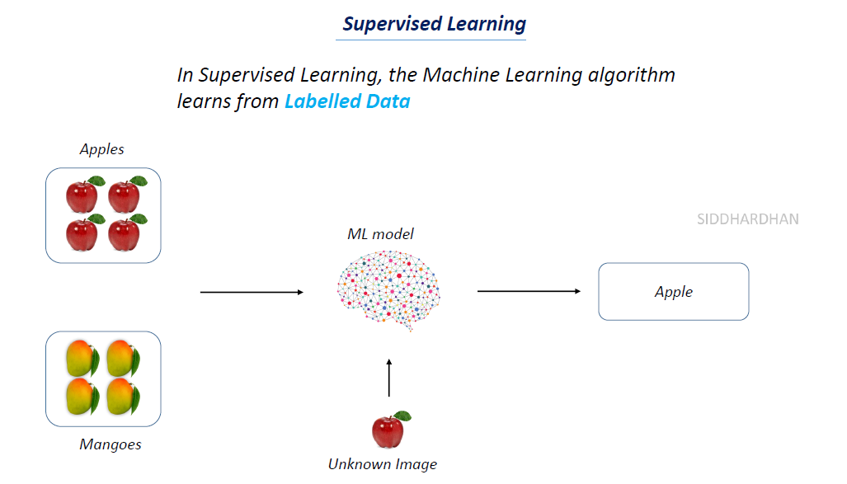

Slide 4
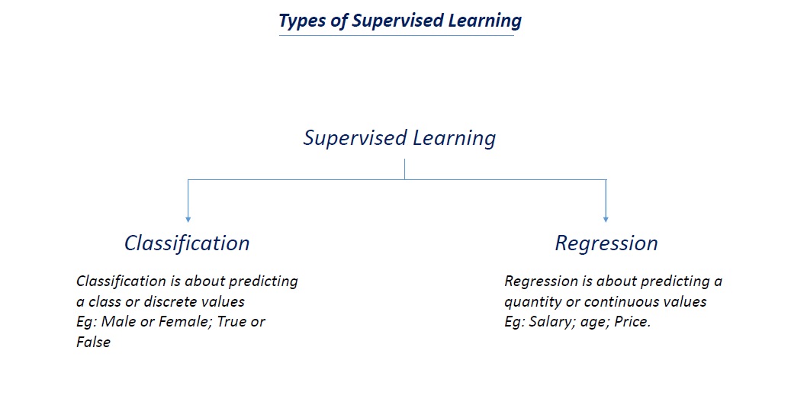

Slide 5
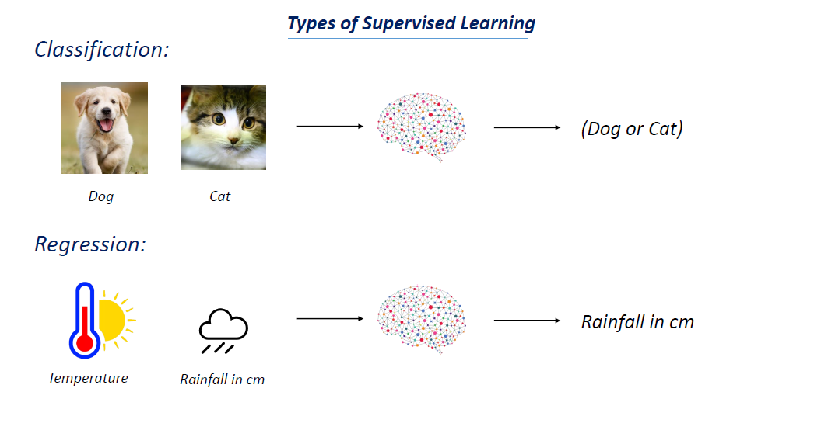

Slide 6
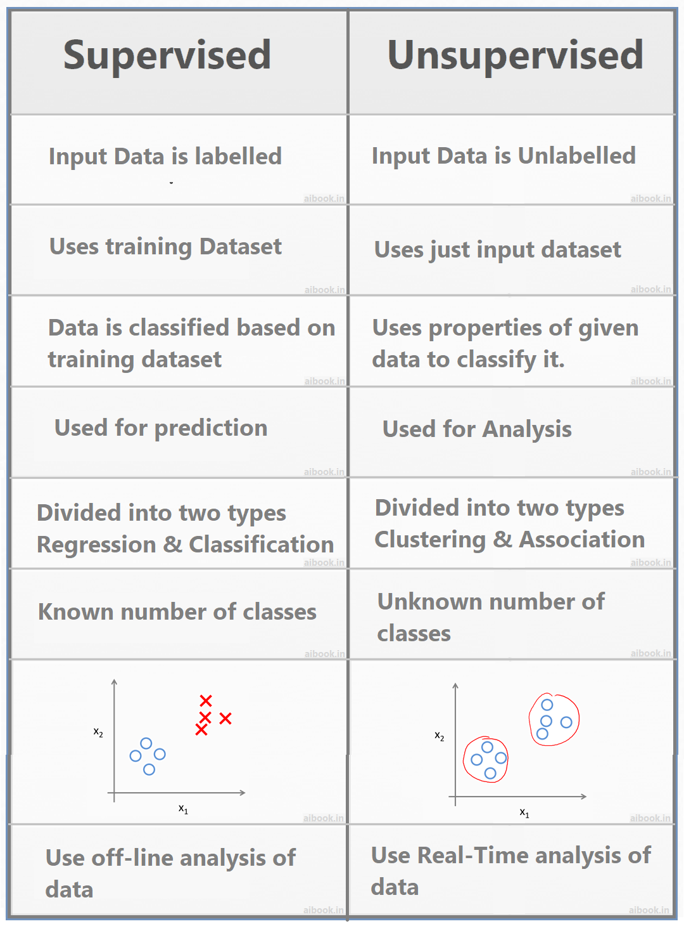

Slide 7
4.1.2 Classification Model

Slide 8
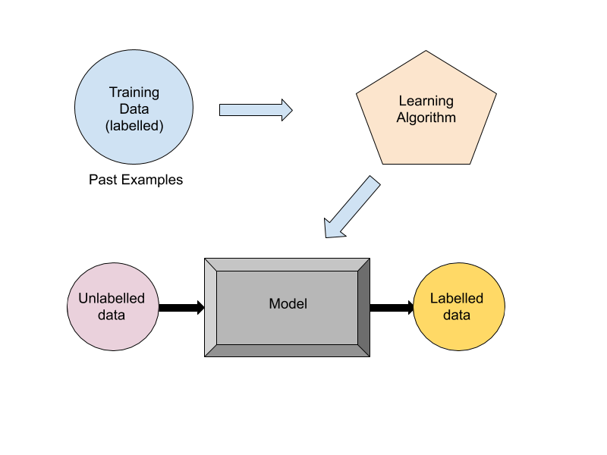

Slide 9
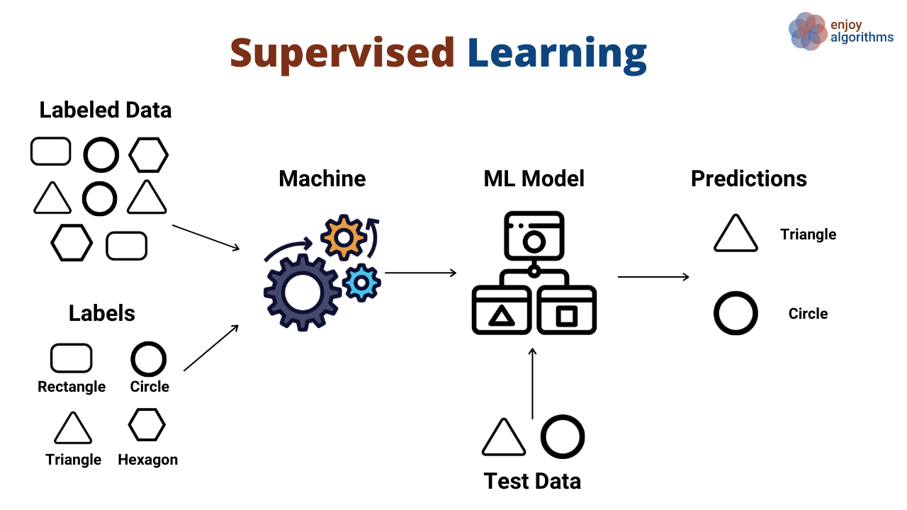

Slide 10
Advantages of Supervised learning:
With the help of supervised learning, the model can predict the output on the basis of prior experiences.
In supervised learning, we can have an exact idea about the classes of objects.
Supervised learning model helps us to solve various real-world problems such as fraud detection, spam filtering, etc.

Slide 11
Disadvantages of supervised learning:
Supervised learning models are not suitable for handling the complex tasks.
Supervised learning cannot predict the correct output if the test data is different from the training dataset.
Training required lots of computation times.
In supervised learning, we need enough knowledge about the classes of object.

Slide 12
4.1.3 Learning steps

Slide 13
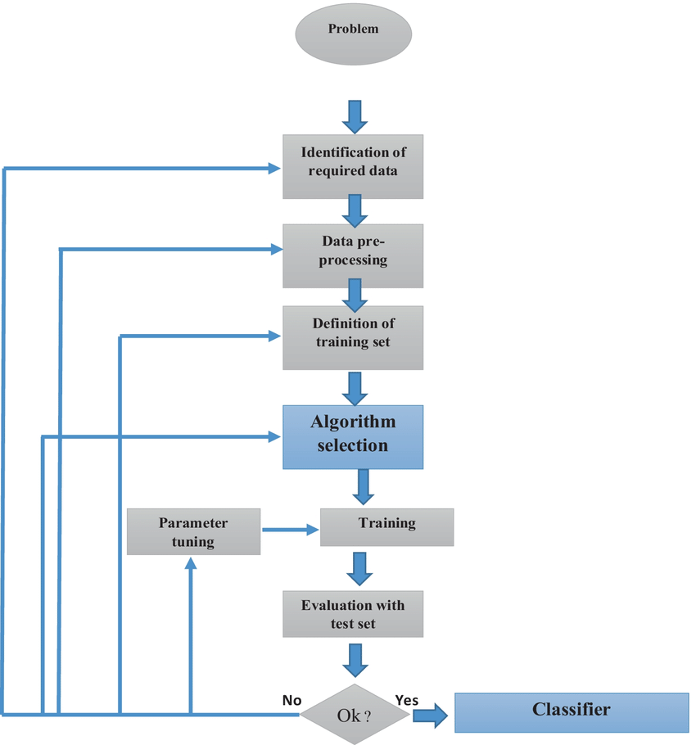

Slide 14
4.2.1 Common Classification Algorithms
k- Nearest Neighbour (kNN)
Support Vectot Machine (SVM)

Slide 15
K Nearest Neighbour
K-Nearest Neighbour is one of the simplest Machine Learning algorithms based on Supervised Learning technique.
K-NN algorithm assumes the similarity between the new case/data and available cases and put the new case into the category that is most similar to the available categories.
K-NN algorithm stores all the available data and classifies a new data point based on the similarity. This means when new data appears then it can be easily classified into a well suite category by using K- NN algorithm.
K-NN algorithm can be used for Regression as well as for Classification but mostly it is used for the Classification problems.

Slide 16
It is also called a lazy learner algorithm because it does not learn from the training set immediately instead it stores the dataset and at the time of classification, it performs an action on the dataset.
KNN algorithm at the training phase just stores the dataset and when it gets new data, then it classifies that data into a category that is much similar to the new data.
Example: Suppose, we have an image of a creature that looks similar to cat and dog, but we want to know either it is a cat or dog. So for this identification, we can use the KNN algorithm, as it works on a similarity measure. Our KNN model will find the similar features of the new data set to the cats and dogs images and based on the most similar features it will put it in either cat or dog category.

Slide 17
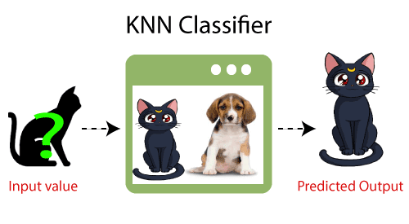

Slide 18
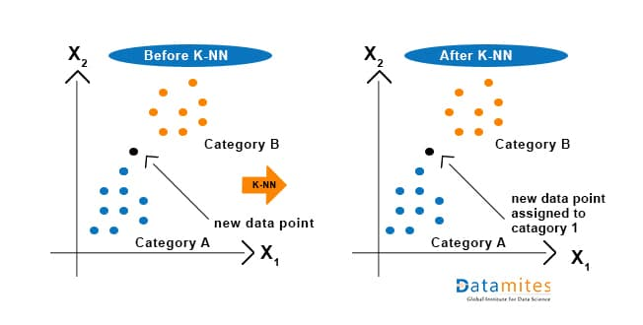
Why do we need a K-NN Algorithm?
Suppose there are two categories, i.e., Category A and Category B, and we have a new data point x1, so this data point will lie in which of these categories. To solve this type of problem, we need a K-NN algorithm. With the help of K-NN, we can easily identify the category or class of a particular dataset. Consider the below diagram:

Slide 19
How does K-NN work?
The K-NN working can be explained on the basis of the below algorithm:
Step-1: Select the number K of the neighbors
Step-2: Calculate the Euclidean distance of K number of neighbors
Step-3: Take the K nearest neighbors as per the calculated Euclidean distance.
Step-4: Among these k neighbors, count the number of the data points in each category.
Step-5: Assign the new data points to that category for which the number of the neighbor is maximum.
Step-6: Our model is ready.

Slide 20
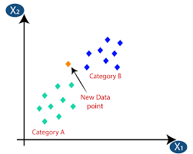
Suppose we have a new data point and we need to put it in the required category. Consider the below image:

Slide 21
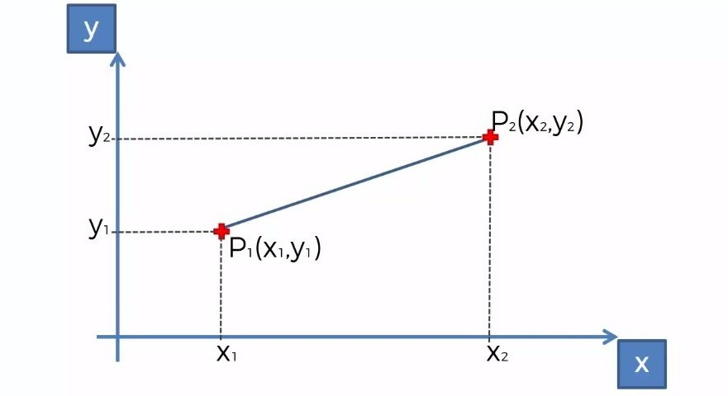
Firstly, we will choose the number of neighbors, so we will choose the k=5.
Next, we will calculate the Euclidean distance between the data points. The Euclidean distance is the distance between two points, which we have already studied in geometry. It can be calculated as:

Slide 22
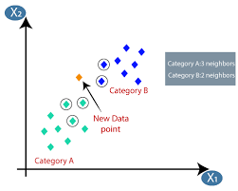
By calculating the Euclidean distance we got the nearest neighbors, as three nearest neighbors in category A and two nearest neighbors in category B. Consider the below image:
As we can see the 3 nearest neighbors are from category A, hence this new data point must belong to category A.

Slide 23
How to select the value of K in the K-NN Algorithm?
There is no particular way to determine the best value for "K", so we need to try some values to find the best out of them. The most preferred value for K is 5.
A very low value for K such as K=1 or K=2, can be noisy and lead to the effects of outliers in the model.
Large values for K are good, but it may find some difficulties.

Slide 24
Advantages of KNN Algorithm:
It is simple to implement.
It is robust to the noisy training data
It can be more effective if the training data is large.
Disadvantages of KNN Algorithm:
Always needs to determine the value of K which may be complex some time.
The computation cost is high because of calculating the distance between the data points for all the training samples.

Slide 25
Support Vector Machine (SVM)

Slide 26
Support Vector Machine or SVM is one of the most popular Supervised Learning algorithms, which is used for Classification as well as Regression problems. However, primarily, it is used for Classification problems in Machine Learning.
The goal of the SVM algorithm is to create the best line or decision boundary that can segregate n-dimensional space into classes so that we can easily put the new data point in the correct category in the future. This best decision boundary is called a hyperplane.

Slide 27
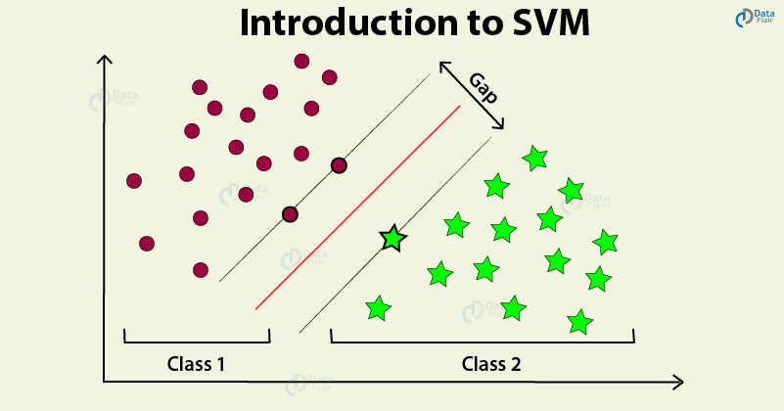
SVM chooses the extreme points/vectors that help in creating the hyperplane. These extreme cases are called as support vectors, and hence algorithm is termed as Support Vector Machine. Consider the below diagram in which there are two different categories that are classified using a decision boundary or hyperplane:

Slide 28
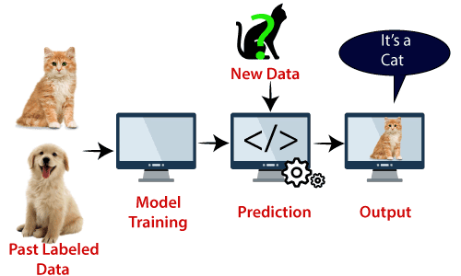
SVM algorithm can be used for Face detection, image classification, text categorization, etc.

Slide 29
Types of SVM
SVM can be of two types:
Linear SVM:
Linear SVM is used for linearly separable data, which means if a dataset can be classified into two classes by using a single straight line, then such data is termed as linearly separable data, and classifier is used called as Linear SVM classifier.
Non-linear SVM:
Non-Linear SVM is used for non-linearly separated data, which means if a dataset cannot be classified by using a straight line, then such data is termed as non-linear data and classifier used is called as Non-linear SVM classifier.

Slide 30
Hyperplane and Support Vectors in the SVM algorithm:
Hyperplane: There can be multiple lines/decision boundaries to segregate the classes in n-dimensional space, but we need to find out the best decision boundary that helps to classify the data points. This best boundary is known as the hyperplane of SVM.
The dimensions of the hyperplane depend on the features present in the dataset, which means if there are 2 features (as shown in image), then hyperplane will be a straight line. And if there are 3 features, then hyperplane will be a 2-dimension plane.
We always create a hyperplane that has a maximum margin, which means the maximum distance between the data points.
Support Vectors:The data points or vectors that are closest to the hyperplane and which affect the position of the hyperplane are termed as Support Vector. Since these vectors support the hyperplane, hence called a Support vector.

Slide 31
How does SVM works?

Slide 32
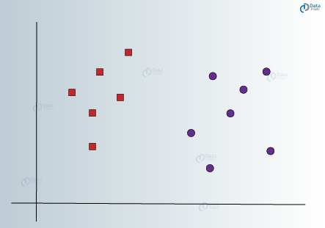
Linear SVM:

Slide 33
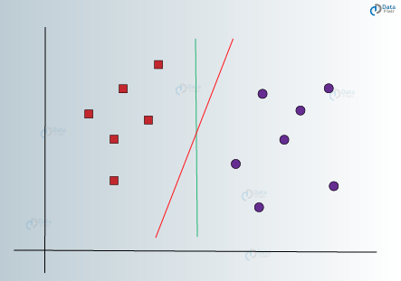
As it is 2-d space so by just using a straight line, we can easily separate these two classes. But there can be multiple lines that can separate these classes. Consider the below image:

Slide 34
Hence, the SVM algorithm helps to find the best line or decision boundary; this best boundary or region is called as a hyperplane.
SVM algorithm finds the closest point of the lines from both the classes. These points are called support vectors.
The distance between the vectors and the hyperplane is called as margin.
And the goal of SVM is to maximize this margin.
The hyperplane with maximum margin is called the optimal hyperplane.

Slide 35
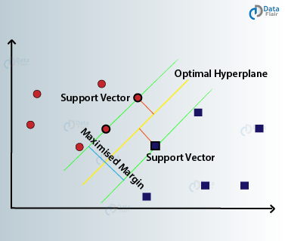

Slide 36
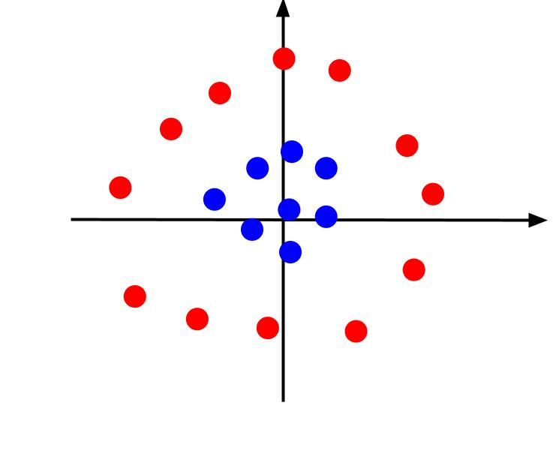
Non-Linear SVM:
So to separate these data points, we need to add one more dimension. For linear data, we have used two dimensions x and y, so for non-linear data, we will add a third dimension z. It can be calculated as:
z=x2 +y2

Slide 37
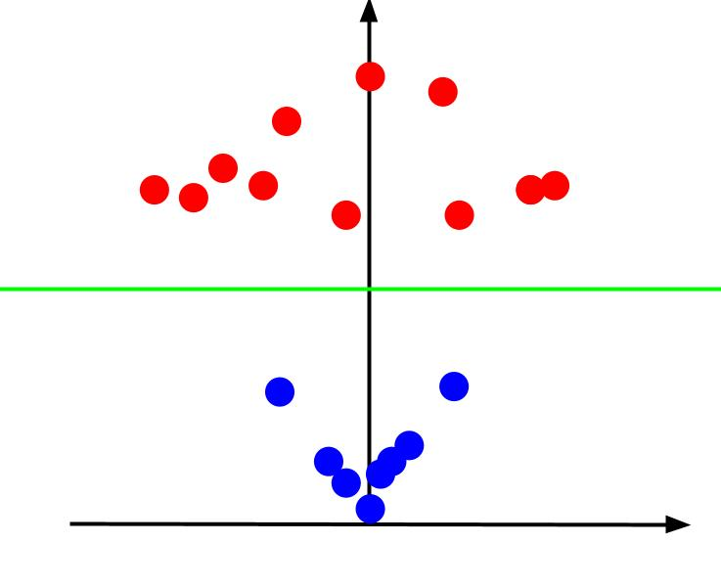
By adding the third dimension, the sample space will become as below image:

Slide 38
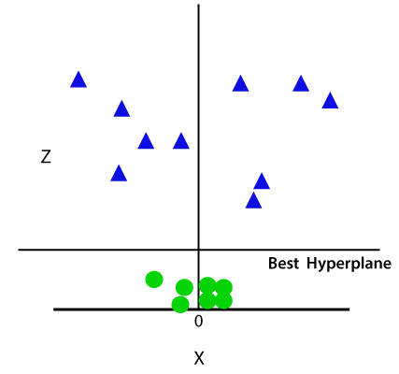
So now, SVM will divide the datasets into classes in the following way. Consider the below image:

Slide 39
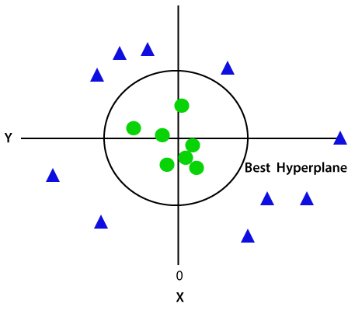
Since we are in 3-d Space, hence it is looking like a plane parallel to the x-axis. If we convert it in 2d space with z=1, then it will become as:
Hence we get a circumference of radius 1 in case of non-linear data.

Slide 40
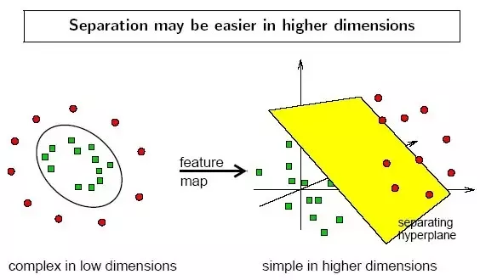

Slide 41
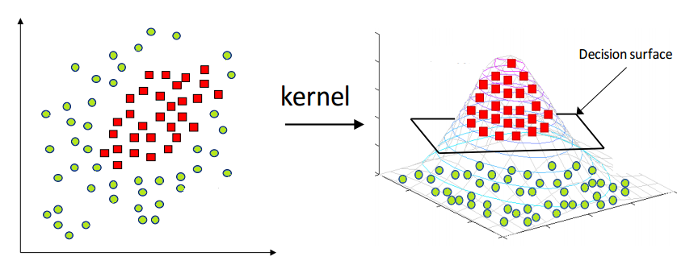

Slide 42
4.3.1 Regression

Slide 43
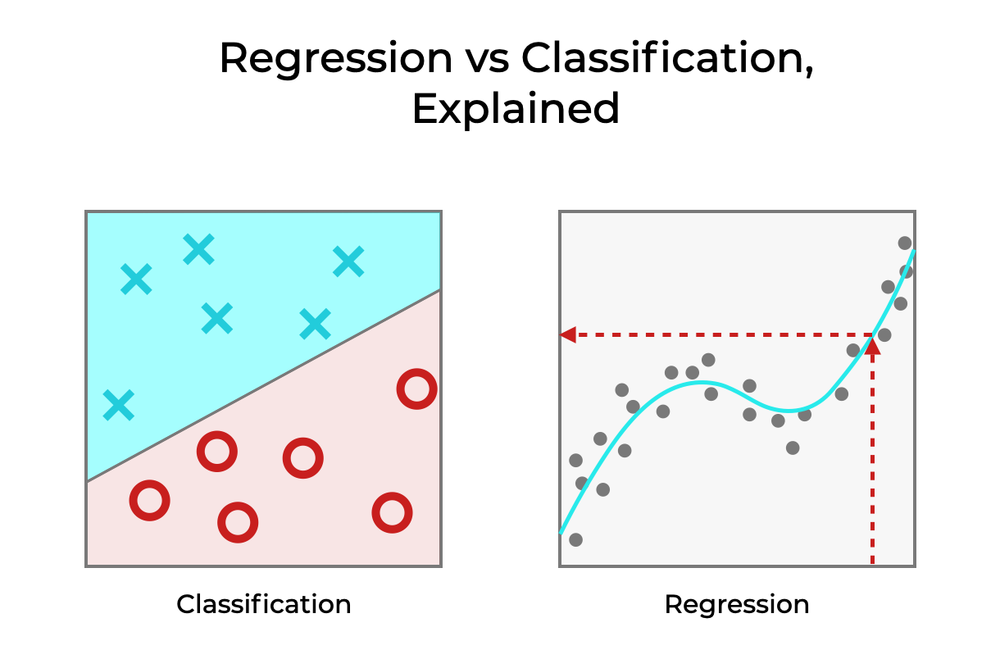

Slide 44
Regression analysis is a statistical method to model the relationship between a dependent (target) and independent (predictor) variables with one or more independent variables. More specifically, Regression analysis helps us to understand how the value of the dependent variable is changing corresponding to an independent variable when other independent variables are held fixed. It predicts continuous/real values such as temperature, age, salary, price, etc.
We can understand the concept of regression analysis using the below example:
Example: Suppose there is a marketing company A, who does various advertisement every year and get sales on that. The below list shows the advertisement made by the company in the last 5 years and the corresponding sales:

Slide 45
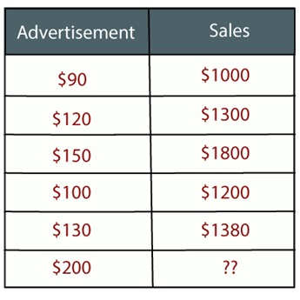
In Regression, we plot a graph between the variables which best fits the given datapoints, using this plot, the machine learning model can make predictions about the data. In simple words, "Regression shows a line or curve that passes through all the datapoints on target-predictor graph in such a way that the vertical distance between the datapoints and the regression line is minimum." The distance between datapoints and line tells whether a model has captured a strong relationship or not.

Slide 46
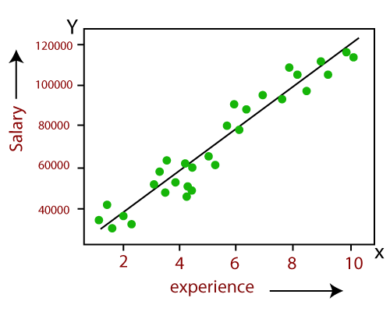
Linear regression shows the linear relationship between the independent variable (X-axis) and the dependent variable (Y-axis), hence called linear regression.
If there is only one input variable (x), then such linear regression is called simple linear regression. And if there is more than one input variable, then such linear regression is called multiple linear regression.
The relationship between variables in the linear regression model can be explained using the below image. Here we are predicting the salary of an employee on the basis of the year of experience.

Slide 47
Below is the mathematical equation for Linear regression:
Y= aX+b
Here, Y = dependent variables (target variables),
X= Independent variables (predictor variables),
a and b are the linear coefficients
Some popular applications of linear regression are:
Analyzing trends and sales estimates
Salary forecasting
Real estate prediction
Arriving at ETAs in traffic.

Slide 48
Simple linear regression

Slide 49
The key point in Simple Linear Regression is that the dependent variable must be a continuous/real value. However, the independent variable can be measured on continuous or categorical values.
Simple Linear regression algorithm has mainly two objectives:
Model the relationship between the two variables. Such as the relationship between Income and expenditure, experience and Salary, etc.
Forecasting new observations. Such as Weather forecasting according to temperature, Revenue of a company according to the investments in a year, etc.

Slide 50
Simple Linear Regression Model:
The Simple Linear Regression model can be represented using the below equation:
y= a0+a1x+ ε
Where,
a0= It is the intercept of the Regression line (can be obtained putting x=0)
a1= It is the slope of the regression line, which tells whether the line is increasing or decreasing.
ε = The error term. (For a good model it will be negligible)

Slide 51
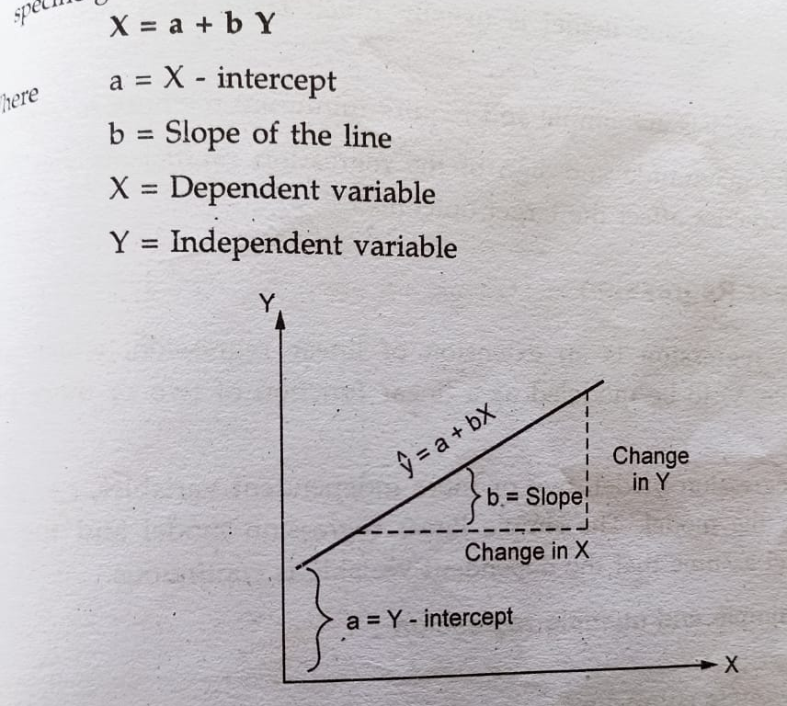

Slide 52
Multiple Linear Regression is one of the important regression algorithms which models the linear relationship between a single dependent continuous variable and more than one independent variable.
Example:
Prediction of CO2 emission based on engine size and number of cylinders in a car.
Some key points about MLR:
For MLR, the dependent or target variable(Y) must be the continuous/real, but the predictor or independent variable may be of continuous or categorical form.
Each feature variable must model the linear relationship with the dependent variable.
MLR tries to fit a regression line through a multidimensional space of data-points.

Slide 53
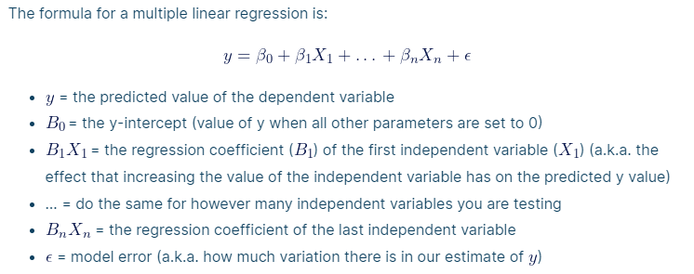
MLR equation:
In Multiple Linear Regression, the target variable(Y) is a linear combination of multiple predictor variables x1, x2, x3, ...,xn. Since it is an enhancement of Simple Linear Regression, so the same is applied for the multiple linear regression equation, the equation becomes:

Slide 54
Assumptions for Multiple Linear Regression:
A linear relationship should exist between the Target and predictor variables.
The regression residuals must be normally distributed.
MLR assumes little or no multicollinearity (correlation between the independent variable) in data.

Slide 55
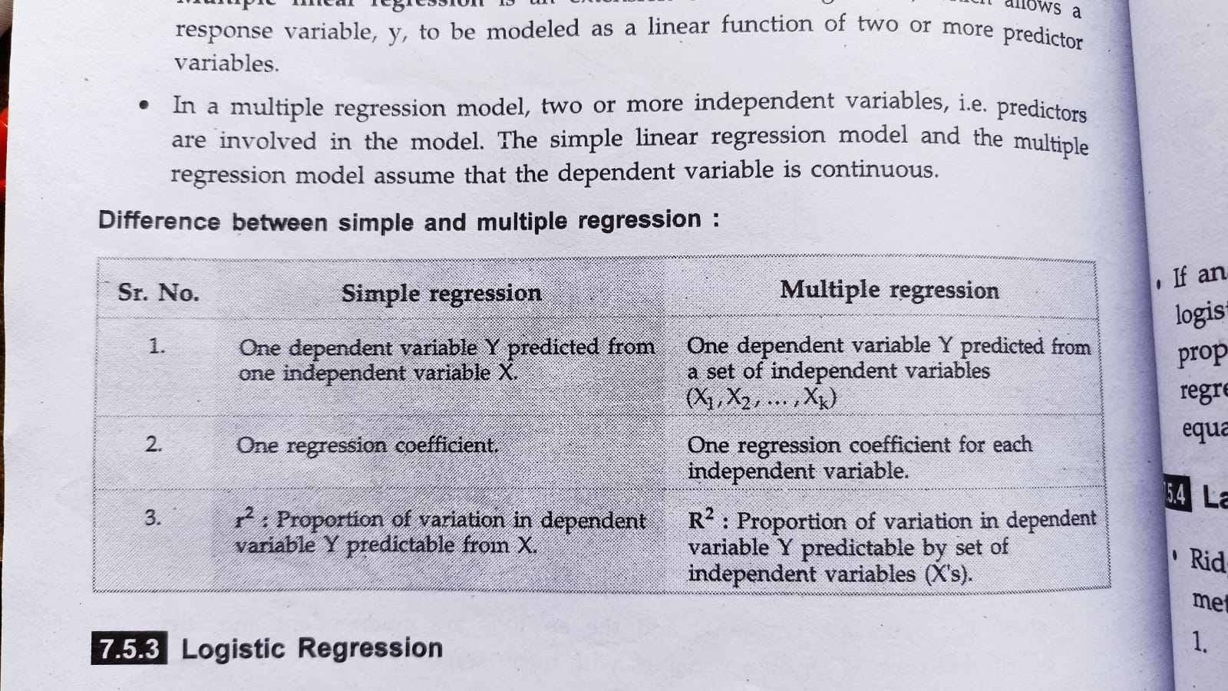

Slide 56
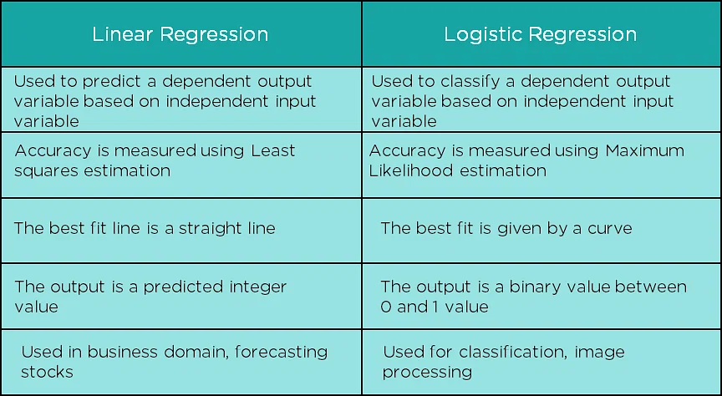

Slide 57
Logistic regression

Slide 58
Logistic regression predicts the output of a categorical dependent variable. Therefore the outcome must be a categorical or discrete value. It can be either Yes or No, 0 or 1, true or False, etc. but instead of giving the exact value as 0 and 1, it gives the probabilistic values which lie between 0 and 1.
Logistic Regression is much similar to the Linear Regression except that how they are used. Linear Regression is used for solving Regression problems, whereas Logistic regression is used for solving the classification problems.
In Logistic regression, instead of fitting a regression line, we fit an "S" shaped logistic function, which predicts two maximum values (0 or 1).
The curve from the logistic function indicates the likelihood of something such as whether the cells are cancerous or not, a mouse is obese or not based on its weight, etc.

Slide 59
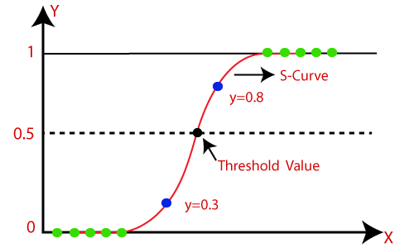
Logistic Regression is a significant machine learning algorithm because it has the ability to provide probabilities and classify new data using continuous and discrete datasets.
Logistic Regression can be used to classify the observations using different types of data and can easily determine the most effective variables used for the classification. The below image is showing the logistic function:

Slide 60
Logistic Function (Sigmoid Function):
The sigmoid function is a mathematical function used to map the predicted values to probabilities.
It maps any real value into another value within a range of 0 and 1.
The value of the logistic regression must be between 0 and 1, which cannot go beyond this limit, so it forms a curve like the "S" form. The S-form curve is called the Sigmoid function or the logistic function.
In logistic regression, we use the concept of the threshold value, which defines the probability of either 0 or 1. Such as values above the threshold value tends to 1, and a value below the threshold values tends to 0.

Slide 61
Assumptions for Logistic Regression:
The dependent variable must be categorical in nature.
The independent variable should not have multi-collinearity.

Slide 62

Logistic Regression Equation:
The Logistic regression equation can be obtained from the Linear Regression equation. The mathematical steps to get Logistic Regression equations are given below:
We know the equation of the straight line can be written as:
In Logistic Regression y can be between 0 and 1 only, so for this let's divide the above equation by (1-y):

Slide 63

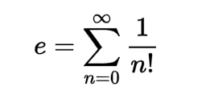
But we need range between -[infinity] to +[infinity], then take logarithm of the equation it will become:
The above equation is the final equation for Logistic Regression.
Euler’s number = 2.718

Slide 64
Type of Logistic Regression:
On the basis of the categories, Logistic Regression can be classified into three types:
Binomial: In binomial Logistic regression, there can be only two possible types of the dependent variables, such as 0 or 1, Pass or Fail, etc.
Multinomial: In multinomial Logistic regression, there can be 3 or more possible unordered types of the dependent variable, such as "cat", "dogs", or "sheep“
Ordinal: In ordinal Logistic regression, there can be 3 or more possible ordered types of dependent variables, such as "low", "Medium", or "High".

Slide 65
Thank You

